Slide 1
Enzyme Structure, classification and mechanism of action

Slide 2
Learning Objectives:
By the end of the lecture, the student should be able to :
Define enzymes and related terms ( active site, apoenzyme, holoenzyme, prosthetic group, enzyme specificity).
Explain the energy of activation.
Describe the structure of enzymes.
Know the Mechanism of action
Explain the Classification of enzymes

Slide 3
Importance
Enzymes play an important role in Metabolism, Diagnosis, and Therapeutics.
All biochemical reactions are enzyme catalyzed in the living organism.
Level of enzyme in blood are of diagnostic importance e.g. it is a good indicator in disease such as myocardial infarction.
Enzyme can be used therapeutically such as digestive enzymes.

Slide 4
Define enzymes
(Enzymes as Biological Catalysts)
Enzymes are proteins that increase the rate of reaction by lowering the energy of activation
They catalyze nearly all the chemical reactions taking place in the cells of the body.
Not altered or consumed during reaction.
Reusable

Slide 5
Important Terms to Understand Biochemical Nature
And Activity of Enzymes
Active site:
The area on the enzyme where the substrate or substrates attach to is called the active site.
Enzymes are usually very large proteins and the active site is just a small region of the enzyme molecule.

Slide 6
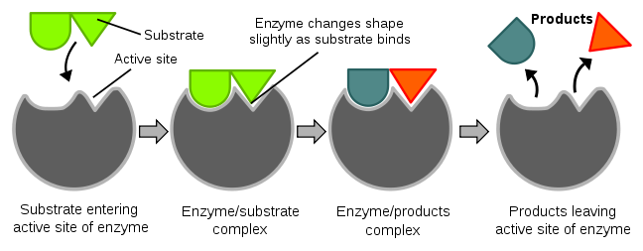
ACTIVE SITES
Enzyme molecules contain a special pocket or cleft called the active sites.
Notes:
The area on the enzyme where the substrate or substrates attach to is called the active site.
Enzymes are usually very large proteins and the active site is just a small region of the enzyme molecule.

Slide 7
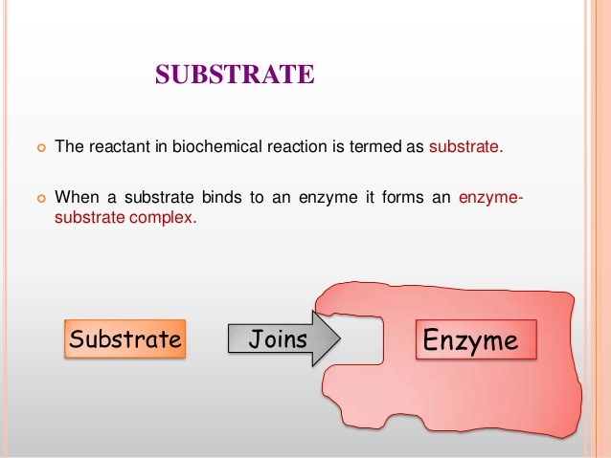
In enzymatic reactions, the substance at the beginning of the process, on which an enzyme begins it’s action is called substrate.

Slide 8
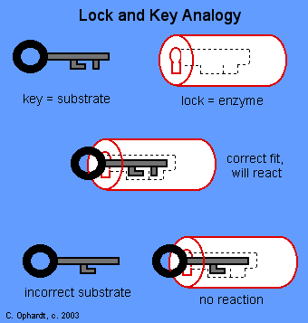
Lock-and-Key Model
In the lock-and-key model of enzyme action:
- the active site has a rigid shape
- only substrates with the matching shape can fit
- the substrate is a key that fits the lock of the active site
This explains enzyme specificity
This explains the loss of activity when enzymes denature

Slide 9
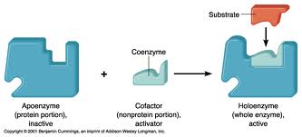
APOENZYME and HOLOENZYME
The enzyme without its non protein moiety is termed as apoenzyme and it is inactive.
Holoenzyme is an active enzyme with its non protein component.

Slide 10
Important Terms to Understand Biochemical Nature
And Activity of Enzymes
Cofactor:
  A cofactor is a non-protein chemical compound that is bound (either tightly or loosely) to an enzyme and is required for catalysis.
  Types of Cofactors:
    Coenzymes.
    Prosthetic groups.

Slide 11
Types of Cofactors
Coenzyme:
The non-protein component, loosely bound to apoenzyme by non-covalent bond.
Examples : vitamins or compound derived from vitamins.
Prosthetic group
The non-protein component, tightly bound to the apoenzyme by covalent bonds is called a Prosthetic group.

Slide 12
Enzyme Specificity
Enzymes have varying degrees of specificity for substrates
Enzymes may recognize and catalyze:
- a single substrate
- a group of similar substrates
- a particular type of bond

Slide 13
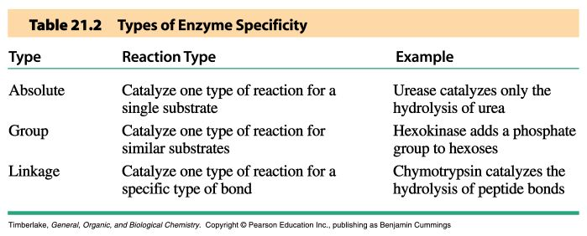

Slide 14
Important Terms to Understand Biochemical Nature
And Activity of Enzymes
Activation energy or Energy of Activation:
All chemical reactions require some amount of energy to get them started.
OR
It is First push to start reaction.
This energy is called activation energy.

Slide 15
Structure of enzymes
Enzymes
Complex or holoenzymes (protein part and nonprotein part – cofactor)
Simple (only protein)
Apoenzyme (protein part)
Cofactor
Prosthetic groups
usually small inorganic molecule or atom;
usually tightly bound to apoenzyme
Coenzyme
-large organic molecule
-loosely bound to apoenzyme

Slide 16
Mechanism of Action of Enzymes
Enzymes increase reaction rates by
decreasing the Activation energy:
Enzyme-Substrate Interactions:
  Formation of Enzyme substrate complex by:
  Lock-and-Key Model
  Induced Fit Model

Slide 17
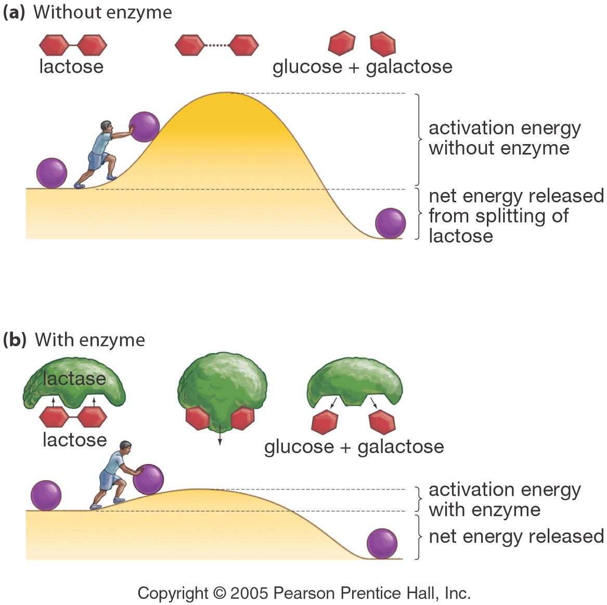
Enzymes Lower a Reaction’s Activation Energy
Notes:
Energy and Enzymes
G. Podgorski, Biol. 1010
Activation energy is the push needed to start a reaction

Slide 18
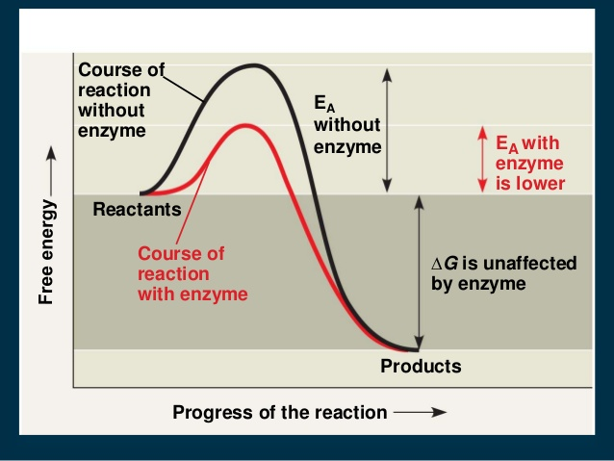

Slide 19
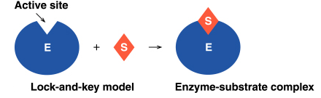
Lock-and-Key Model
In the lock-and-key model of enzyme action:
- the active site has a rigid shape
- only substrates with the matching shape can fit
- the substrate is a key that fits the lock of the active site
This is an older model, however, and does not work for all enzymes

Slide 20
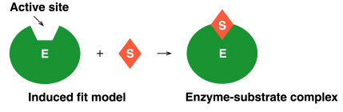
Induced Fit Model
In the induced-fit model of enzyme action:
- the active site is flexible, not rigid
- the shapes of the enzyme, active site, and substrate adjust to maximumize the fit, which improves catalysis
- there is a greater range of substrate specificity
This model is more consistent with a wider range of enzymes

Slide 21
Enzyme Catalyzed Reactions
When a substrate (S) fits properly in an active site, an enzyme-substrate (ES) complex is formed:
E + S  ES
Within the active site of the ES complex, the reaction occurs to convert substrate to product (P):
ES → E + P
The products are then released, allowing another substrate molecule to bind the enzyme
- this cycle can be repeated millions (or even more) times per minute
The overall reaction for the conversion of substrate to product can be written as follows:
E + S  ES → E + P

Slide 22
Enzyme-substrate complex
Step 1:
Enzyme and substrate combine to form complex
E + S ES
Enzyme Substrate Complex
+

Slide 23
Enzyme-product complex
Step 2:
An enzyme-product complex is formed.
ES EP
ES
transition state
EP
Notes:
Within the active site of the ES complex, the reaction occurs to convert substrate to product (P):

Slide 24
Product
The enzyme and product separate
EP E + P
The product
is made
Enzyme is ready
for
another
substrate.
EP
Notes:
The products are then released, allowing another substrate molecule to bind the enzyme
- this cycle can be repeated millions (or even more) times per minute
The overall reaction for the conversion of substrate to product can be written as follows:
E + S  ES → E + P

Slide 25
What Affects Enzyme Activity?
Three factors:
1. Environmental Conditions
2. Cofactors and Coenzymes
3. Enzyme Inhibitors

Slide 26
1. Environmental Conditions
1. Extreme Temperature are the most dangerous
- high temps may denature (unfold) the enzyme.
2. pH (most like 6 - 8 pH near neutral)
3. substrate concentration .

Slide 27
2. Cofactors and Coenzymes
Inorganic substances (zinc, iron) and vitamins (respectively) are sometimes need for proper enzymatic activity.
Example:
  Iron must be present in the quaternary structure - hemoglobin in order for it to pick up oxygen.

Slide 28
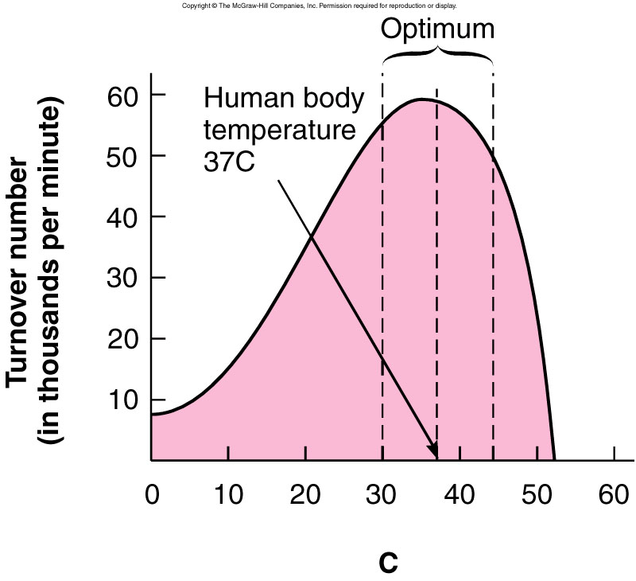
Environmental factors
Optimum temperature The temp at which enzymatic reaction occur fastest.
Notes:
The temp at which enzymatic reaction occur fastest is called Optimum temperature

Slide 29
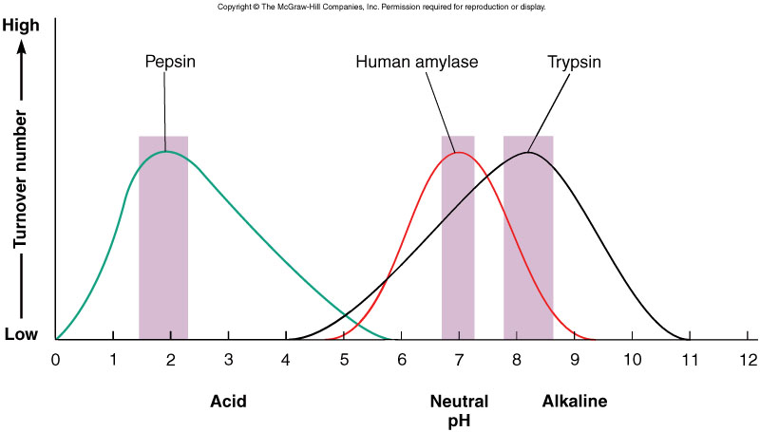
Environmental factors
pH also affects the rate of enzyme-substrate complexes
  Most enzymes have an optimum pH of around 7 (neutral)
    However, some prefer acidic or basic conditions
Notes:
pepsin (a stomach enzyme) functions best at a low (acidic) pH. At pH 1, pepsin is in it’s functional shape; it would be able to bind to its substate. At pH 5, the enzyme’s shape is different and it no longer has an active site able to bind the substrate. The change in enzyme activity is observed as a difference in reaction rate.

Slide 30
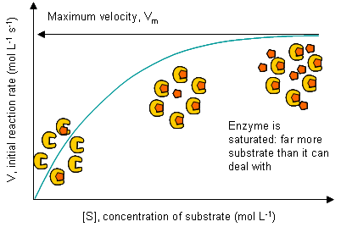
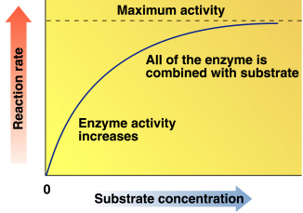
Substrate Concentration and Reaction Rate
The rate of reaction increases as substrate concentration increases (at constant enzyme concentration)
Maximum activity occurs when the enzyme is saturated (when all enzymes are binding substrate)

Slide 31
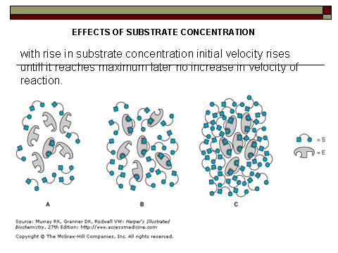

Slide 32
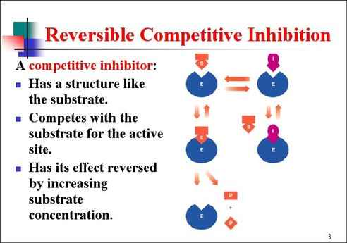
Enzyme Inhibitors
Competive - mimic substrate, may block active site, but may dislodge it.

Slide 33
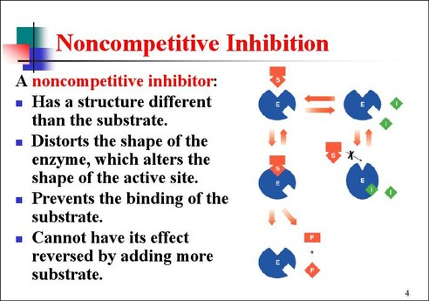
Enzyme Inhibitors
Noncompetitive

Slide 34
Naming Enzymes
The name of an enzyme in many cases end in –ase
For example, sucrase catalyzes the hydrolysis of sucrose
The name describes the function of the enzyme
For example, oxidases catalyze oxidation reactions
Sometimes common names are used, particularly for the digestion enzymes such as pepsin and trypsin
Some names describe both the substrate and the function
For example, alcohol dehydrogenase oxides ethanol

Slide 35
Enzymes Are Classified into six functional Classes (EC number Classification) by the International Union of Biochemists (I.U.B.). on the Basis of the Types of
Reactions That They Catalyze
EC 1. Oxidoreductases
EC 2. Transferases
EC 3. Hydrolases
EC 4. Lyases
EC 5. Isomerases
EC 6. Ligases

Slide 36
Principle of the international classification
Each enzyme has classification number
consisting of four digits:
Example, EC: (2.7.1.1) HEXOKINASE

Slide 37
EC: (2.7.1.1) these components indicate the following groups of enzymes:
2. IS CLASS (TRANSFERASE)
7. IS SUBCLASS (TRANSFER OF PHOSPHATE)
1. IS SUB-SUB CLASS (ALCOHOL IS PHOSPHATE ACCEPTOR)
1. SPECIFIC NAME
ATP,D-HEXOSE-6-PHOSPHOTRANSFERASE (Hexokinase)

Slide 38
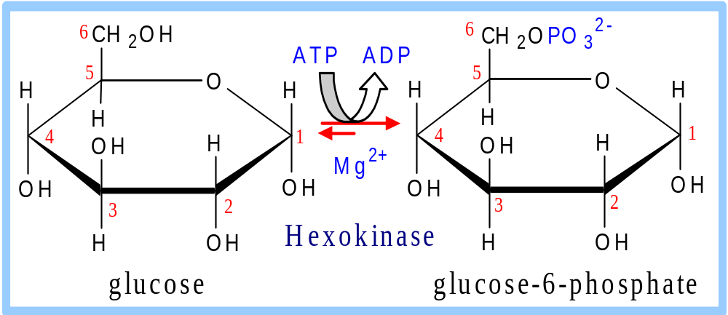
1. Hexokinase catalyzes:
Glucose + ATP → glucose-6-P + ADP

Slide 39
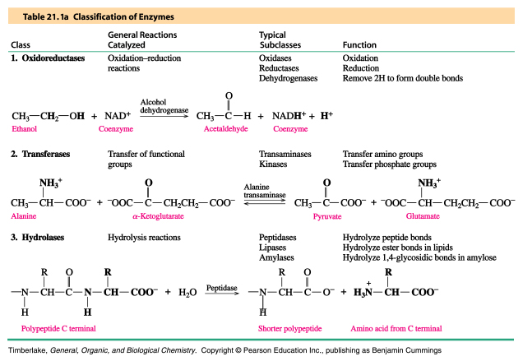
Oxidoreductases, Transferases and Hydrolases

Slide 40
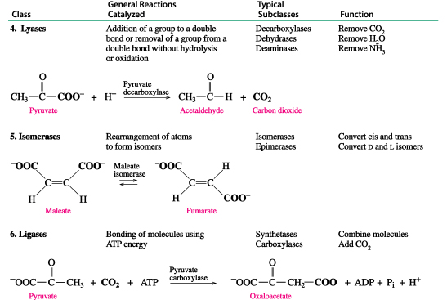
Lyases, Isomerases and Ligases

Slide 41
EC 1. Oxidoreductases
Biochemical Activity:
  Catalyse Oxidation/Reduction Reactions Act on many chemical groupings to add or remove hydrogen atoms.
Examples:
  Lactate dehydrogenase.
  Glucose Oxidase.
  Peroxidase.
  Catalase.
  Phenylalanine hydroxylase.

Slide 42
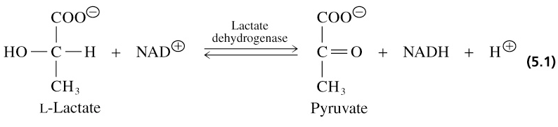
1. Oxidoreductases
Catalyze oxidation-reduction reactions
- oxidases - peroxidases - dehydrogenases

Slide 43
EC 2. Transferases
Biochemical Activity:
  Transfer a functional groups (e.g. methyl or phosphate) between donor and acceptor molecules.
Examples:
  Transaminases (ALT & AST).
  Phosphotransferases (Kinases).
  Transmethylases.
  Transpeptidases.
  Transacylases.
Notes:
Kinases are specialized transferases that regulate metabolism by transferring phosphate from ATP to other molecules.AST,ALT,hexokinase
Kinases are specialized transferases that regulate metabolism by transferring phosphate from ATP to other molecules.AST,ALT,hexokinase

Slide 44
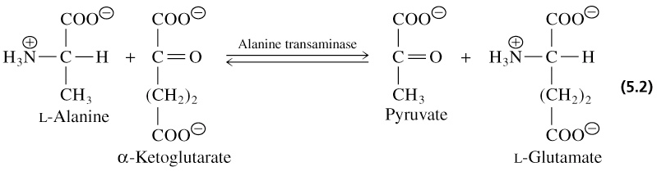
2. Transferases
Catalyze group transfer reactions

Slide 45
EC 3. Hydrolases
Biochemical Activity:
  Catalyse the hydrolysis of various bonds Add water across a bond.
Examples:
  Protein hydrolyzing enzymes (Peptidases).
  Carbohydrases (Amylase, Maltase, Lactase).
  Lipid hydrolyzing enzymes (Lipase).
  Deaminases.
  Phosphatases.

Slide 46
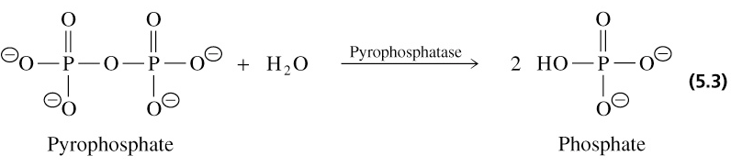
3. Hydrolases
Catalyze hydrolysis reactions where water is the acceptor of the transferred group
- esterases - peptidases - glycosidases

Slide 47
EC 4. Lyases
Biochemical Activity:
  Cleave various bonds by means other than hydrolysis and oxidation.
  Add Water, Ammonia or Carbon dioxide across double bonds, or remove these elements to produce double bonds.
Examples:
  Fumarase.
  Carbonic anhydrase.

Slide 48
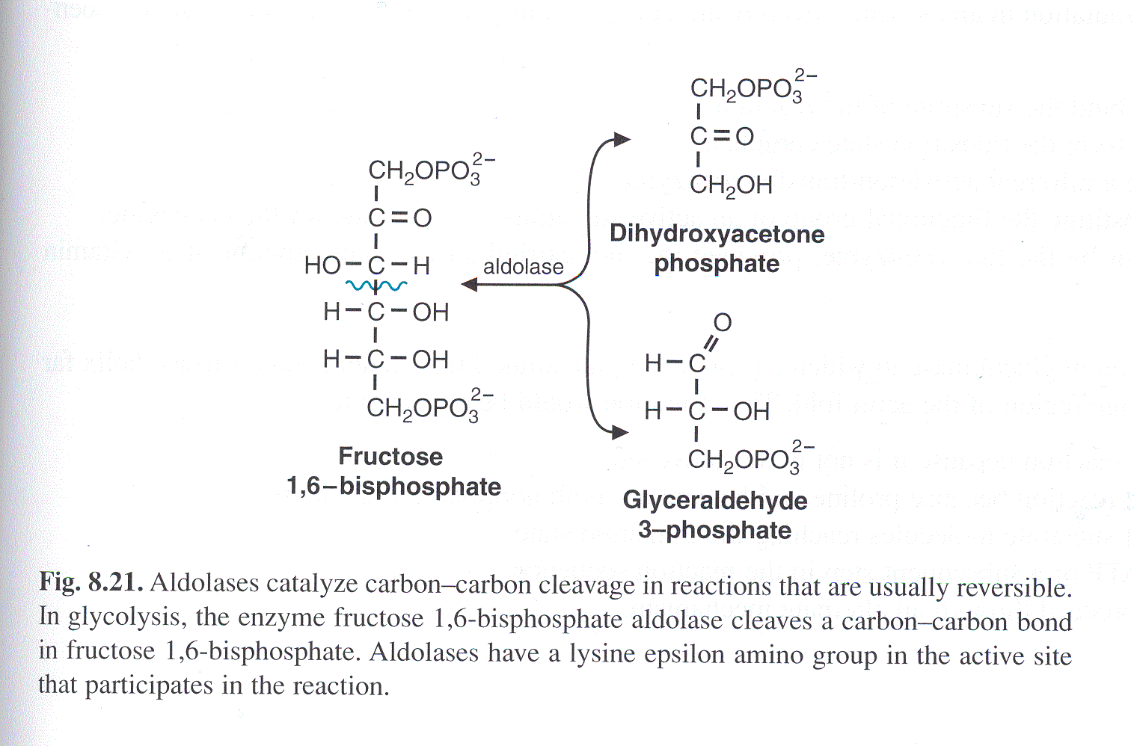
4. Lyases

Slide 49
EC 5. Isomerases
Biochemical Activity:
  Catalyse isomerization changes within a single molecule.
  Carry out many kinds of isomerization:
    L to D isomerizations.
    Mutase reactions (Shifts of chemical groups).
Examples:
  Isomerase.
  Mutase.
Notes:
Isomerases are a general class of enzymes which convert a molecule from one isomer to another.. The general form of such a reaction is as follows:
A–B → B–A

Slide 50
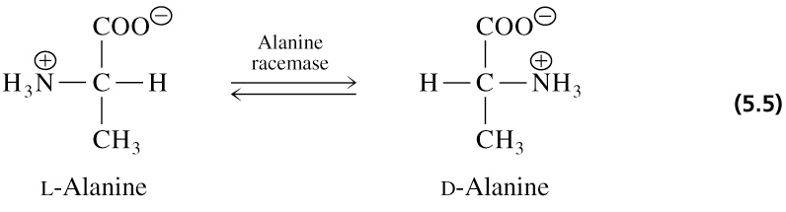
5. Isomerases
Catalyze isomerization reactions
Notes:
facilitate intramolecular rearrangements in which bonds are broken and formed or they can catalyze conformational changes.

Slide 51
EC 6. Ligases
Biochemical Activity:
  Join two molecules with covalent bonds Catalyse reactions in which two chemical groups are joined (or ligated) with the use of energy from ATP.
Examples:
  Acetyl~CoA Carboxylase.
  Glutamine synthetase

Slide 52
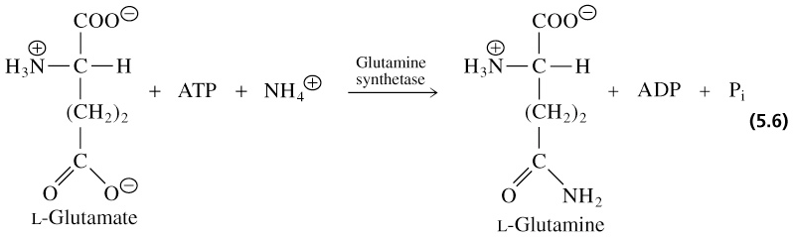
6. Ligases (synthetases)
Catalyze ligation, or joining of two substrates
Require chemical energy (e.g. ATP)

Slide 53
